Slide 1

Proposal For Predictive Analysis of Prices of Crypto -Currencies
BY:
UTKARSH SINGH
ABHYUDAYA P.SINGH
PRATIK PARIDA
Student - KIIT

Slide 2

INTRODUCTION:
Crypto-currency is a digital asset designed to work as a medium of exchange that uses cryptography .
The supply and values are controlled by the activities of their users.
First decentralized crypto-currency : Bitcoin, was created in 2009 by pseudonymous developer Satoshi Nakamoto.

Slide 3

Ripple is a real-time gross settlement system (RTGS), currency exchange created by the Ripple company. It is built upon a distributed open source Internet protocol, consensus ledger and native crypto-currency called XRP (ripples).
Initial Release : 2012
Written in : C++
Arthur Britto, David Schwartz, Ryan Fugger

Slide 4

WHY CHOOSE RIPPLE?
Ripple is based around a shared and public database.
Among its validators are companies, internet service providers, and the Massachusetts Institute of Technology.
"from banks' perspective, distributed ledgers like the Ripple system have a number of advantages over cryptocurrencies like bitcoin."

Slide 5

Problem Formulation and Research Question
Crypto-currency is dependent on various factors that decide the its price in the market :
Demand and Supply
Market Sentiment
Government Regulation
Stability of the particular Crypto-currency network
Wider Mainstream Acceptance
Many investors aren’t interested to pay attention to the following factors. The only thing they are concerned with is the price of the crypto-currency at present and in the future.

Slide 6
In this project we formulate a method to predict the future price of Ripple so as to help the investors and shareholders to have a better idea of what to expect in the upcoming days , thus buy and sell accordingly.

Slide 7


EXPERIMENTAL SETUP
For the following research, Integrated Development Environment (IDE) Spyder was used with Python 3.6.
The python packages used for the following were. Pandas, Numpy, pip, html5lib, Scipy , Seaborn , Matplotlib , Statsmodels .

Slide 8

DATASET & ITS’ PROCESSING
Acquired from coinmarketcap.com
Directly extracted from the website.
Packages used were Html5lib and Beautifulsoup4.
Data was Then cleansed.

Slide 9
Parameters stressed upon to develop our model and get to a conclusion :
Market Cap
Volume
Open/Close
High/Low

Slide 10

Model specification
we designed the ARIMA model to carry out our predictions as it captures a suite of different standard temporal structures in time series data and effectively exploits the time series analysis method for predictions. ARIMA is an acronym that stands for Auto Regressive Integrated Moving Average.

Slide 11
ARIMA Model
This acronym are:
AR : Auto regression. It uses the dependent relationship between an observation and some number of lagged observations.
I: Integrated. The use of differencing of raw observations in order to make the time series stationary.
MA: Moving Average. A model that uses the dependency between an observation and a residual error applied to lagged observations.

Slide 12
The parameters of the ARIMA model are defined as follows:
p: The number of lag observations
d: The number of times that the raw observations are differenced.
q: order of moving average

Slide 13
ARIMA Model is specified as ARIMA(p,d,q) derived from the ARMA Model . Various types of ARIMA model are :
ARIMA(1,0,0) : First Order Auto regression Model
ARIMA(0,1,0) : Random walk
ARIMA(1,1,0) : Differenced ARIMA(1,0,0)

Slide 14
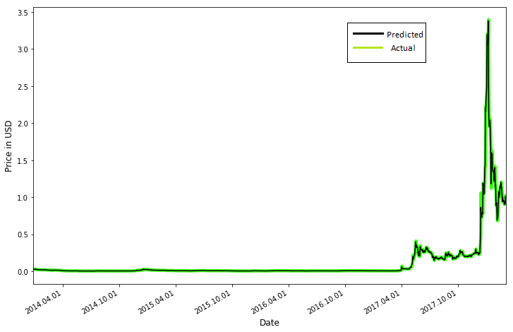
RESULT AND ANALYSIS

Slide 15
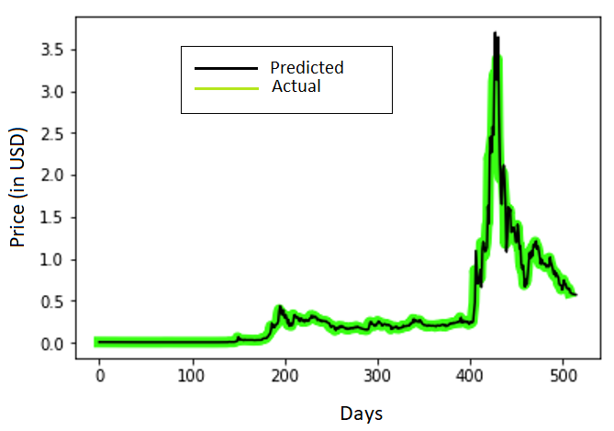
Prediction for the next 7 days :

Slide 16

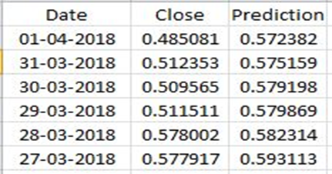
CONCLUSION
Based on the available dataset, the closing price(U.S.D.) was
calculated for the next six days:
We Calculated the accuracy of our model On the basis of Mean Squared Error and Variance of the result.
The mean squared error calculated was 0.01 and the variance
score was 0.97 which was indeed satisfactory.

Slide 17
THANK YOU

Slide 18


